Slide 1
Topic 3: Temperature
3.1 Thermal equilibrium
3.2 Temperature scales
3.3 Practical thermometers

Slide 2
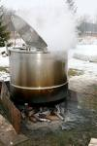
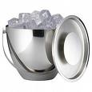
What is Temperature?
HOT
Temperature tells us how hot or cold a body is.
COLD
It measures the degree of hotness or coldness of a substance.

Slide 3


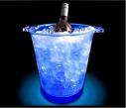
Temperature Vs Heat
Heat is energy transferred from one body to another due to a difference in temperature between the two bodies.
Heat always flow from a body of higher temperature to one of lower temperature.
Heat flows from the hot water to the cans.
Heat flows from the bottle to the ice cubes.

Slide 4


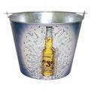
Thermal Equilibrium
When two bodies are in thermal contact and a condition is reached where there is no net transfer of heat from one body to another, then the two bodies are said to be in thermal equilibrium.
When in thermal equilibrium, both the bodies have the same temperature.

Slide 5
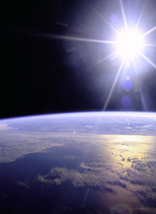
Thermal Equilibrium
Thermal contact is not necessarily physical contact e.g the Sun is not in physical contact with the Earth but they are in thermal contact as heat is being transferred from the Sun to the Earth.
X
Y
Heat
X
Y
X
Y
In Thermal Contact
Heat flows from higher temperature to lower temperature
In Thermal Equilibrium
No net heat-flow
Same temperature

Slide 6
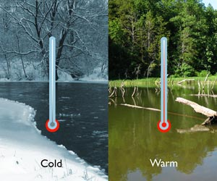
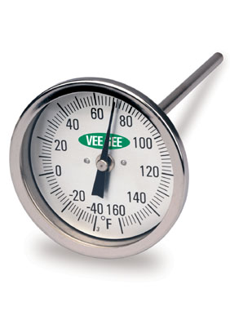
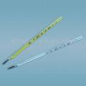
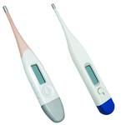

What Instrument is Used to Measure Temperature?
We use a thermometer to measure temperature.

Slide 7

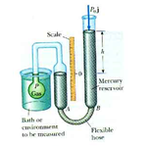
How Does a Thermometer Measure Temperature?
Thermometry is the study of the principles used in the measurement of temperature.
Any physical property that varies monotonically (in one direction) with temperature can be used to measure temperature.
Such properties are called thermometric properties.

Slide 8
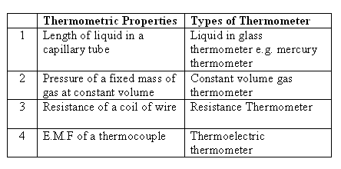
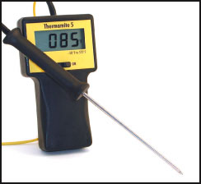
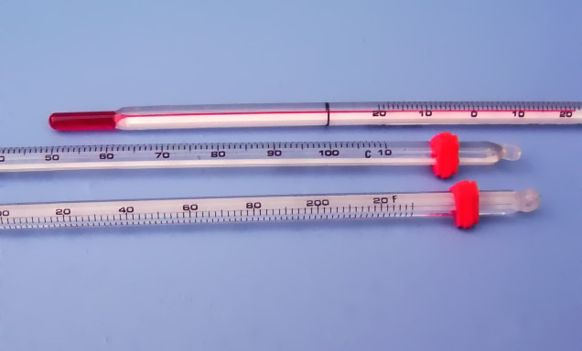
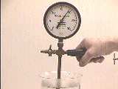
Some Thermometric Properties

Slide 9
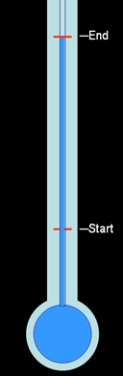
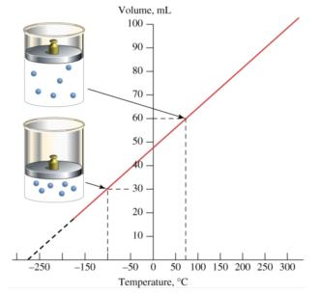
Scale of Temperature
A scale of temperature needs the following:
A thermometric property
Two fixed points
A numerical scale

Slide 10
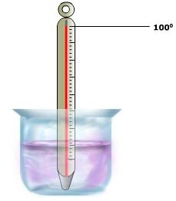
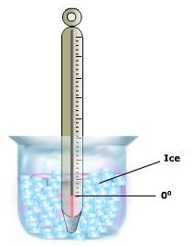
The Fixed Points
A fixed point is a temperature where all thermometers show the same reading. A temperature chosen as a fixed point,
  Should be easily reproduced
  Can be precisely reproduced
In the Celsius scale of temperature, the lower fixed point is the ice point, where ice and pure water are in equilibrium at standard atmospheric pressure. The ice point is fixed as 0ºC.
And the upper fixed point, is the steam point of pure water and its vapour. It is fixed as 100ºC.

Slide 11
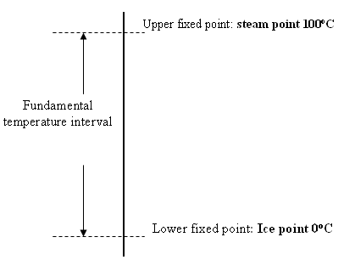
Numerical Scale
The temperature interval between the ice point and the steam point is known as the fundamental interval.
In the centigrade scale, the fundamental temperature interval is divided into 100 equal divisions. Each division is known as one degree centigrade.

Slide 12
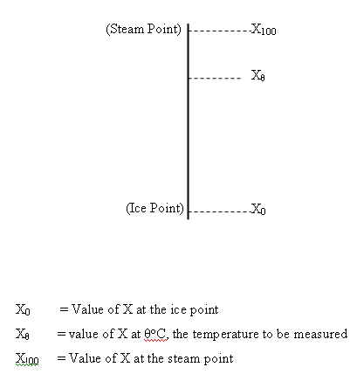
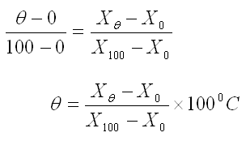
Empirical Scale of Temperature
Assuming that the temperature property X varies linearly with temperature,
Scales constructed in this way are known as empirical temperatures scales.

Slide 13
Example
The length of a mercury column in a mercury thermometer is 15.3 mm at the ice point and 47.8 mm at the steam point. What is the temperature on the centigrade scale of this thermometer when the length of the column is 21.6 mm?
The resistance of a piece of platinum is 3.254 Ω at the ice point and 4.517 Ω at the steam point. It is used to measure the temperature as in (a) and its resistance is 3.494 Ω. What is the temperature on the centigrade scale of this thermometer?
Comment on the discrepancy between the two temperatures measured.
Solution:
θ = (21.6 – 15.3) / (47.8 – 15.3) × 100 = 19.4 ºC
θ = (3.494 – 3.254) / (4.517 – 3.254) × 100 = 19.0 ºC
The two thermometric properties react differently to the temperature change.
The thermometric properties may not vary linearly with temperature change.

Slide 14
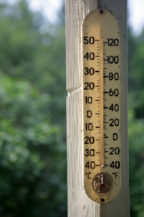
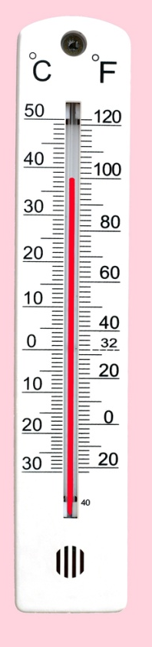
Scales of Temperature
3 scales:
Fahrenheit (ºF)
Celsius (ºC)
Kelvin (K)

Slide 15
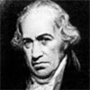
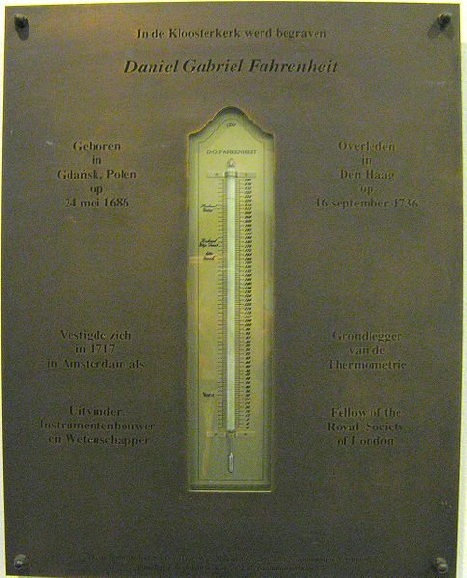
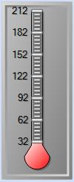
Fahrenheit(not in syllabus)
Daniel Gabriel Fahrenheit (1686-1736)
was a German physicist
invented the alcohol thermometer in 1709
invented the mercury thermometer in 1714.
Developed the Fahrenheit temperature scale 1724.
Fahrenheit originally used the temperature of an ice-water-salt mixture as the lower fixed point.
And the body temperature as the upper fixed point
The melting point of water corresponds to 32ºF and the boiling point to 212 ºF
The Fahrenheit scale is still used in USA but no longer used for scientific purpose.
1686-1736
Notes: The Fahrenheit scale is not in the syllabus, just for your understanding.
Notes:
Although the Fahrenheit scale was formerly used widely in English-speaking countries, many of these countries began changing to the more convenient Although the Fahrenheit scale was formerly used widely in English-speaking countries, many of these countries began changing to the more convenient Celsius temperature scale in the late 1960s and early 1970s; a notable exception is the United States, where the Fahrenheit scale is still in common use together with other English units of measurement.

Slide 16

Celsius
Anders Celsius (1701-1744)
a Swedish astronomer
invented the centigrade scale in 1742.
Celsius chose the melting point of ice and the boiling point of water as his two reference temperatures.
Celsius divided the difference in temperature between the freezing and boiling points of water into 100 degrees (thus the name centi, meaning one hundred, and grade, meaning degrees).
After Celsius's death, the centigrade scale was renamed the Celsius scale.
1701-1744

Slide 17
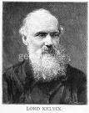
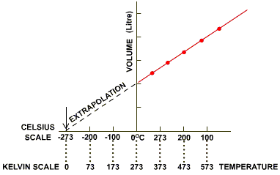
Kelvin
Lord William Kelvin (1824-1907)
a Scottish physicist
devised the Kelvin (K) scale in 1854.
The Kelvin scale is based on the idea of absolute zero, the theoretical temperature at which all molecular motion stops and no discernable energy can be detected
In theory, the zero point on the Kelvin scale is the lowest possible temperature that exists in the universe: -273.15ºC.
The Kelvin scale uses the same unit of division as the Celsius scale
it resets the zero point to absolute zero: -273.15ºC. The freezing point of water is therefore 273.15 K and the boiling point 373.15 K.
1824-1907
-273.15ºC

Slide 18
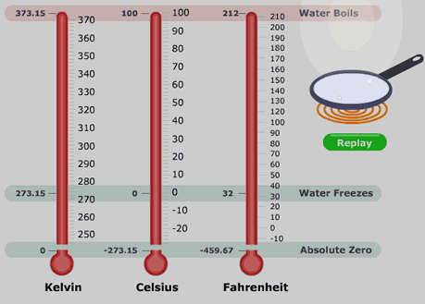
The 3 Scales of Temperature
Not in syllabus
T = (θ ºC + 273.15) K

Slide 19
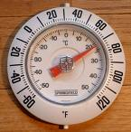
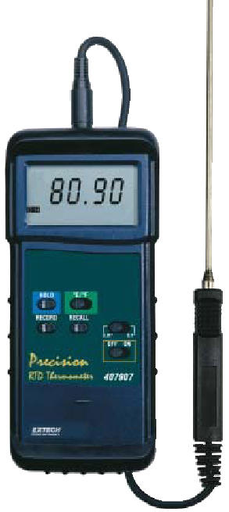
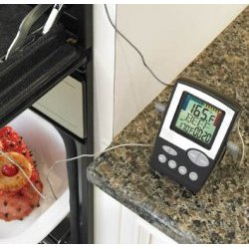

Practical Thermometers
Mercury-in-glass thermometer
Gas Thermometer
Electric Thermometers
  Thermocouple / Thermoelectric Thermometer
  Resistance thermometer
Pyrometer

Slide 20
Mercury-in-glass Thermometer
The thermometric parameter for this type of thermometer is the length of mercury column l.
The temperature θ of a substance is determined by comparing the mercury length l:
θ = (l_{θ} – l₀) / (l₁₀₀ – l₀) × 100 ⁰C

Slide 21
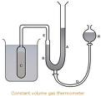
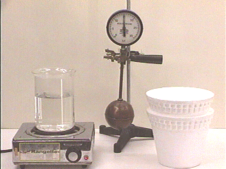
Gas Thermometer
In most accurate work, temperatures are measured by gas thermometers, for example, by the changes in pressure of a gas at constant volume.
In practice, gas thermometers are used for calibrating electrical thermometers – resistance and thermocouple thermometers.
For a temperature of θ K,
θ = (p_{θ} / (p_{tr}) × 273.16 K where
p_{θ}, and p_{tr} are respectively the gas pressure at the unknown temperature θ, and at the triple point.

Slide 22
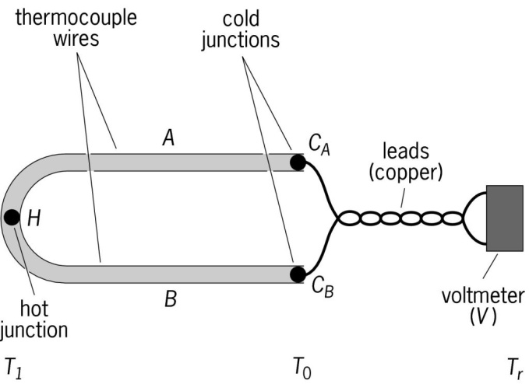
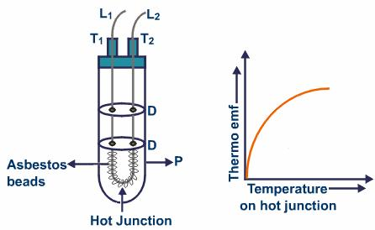
Thermocouple Thermometer (Thermoelectric)
The thermocouple thermometer consists of two wires of different metals joined at each end.
One junction is placed where the temperature is to be measured, and the other is kept at a constant lower (reference) temperature.
A measuring instrument is connected in the electrical circuit. The temperature difference causes the development of an electromotive force that is approximately proportional to the difference between the temperatures of the two junctions.
Temperature can be read from standard tables, or the instrument can be calibrated to display temperature directly.

Slide 23
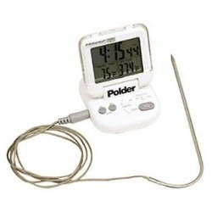
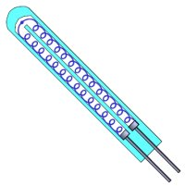
Resistance Thermometer
The measuring element of a resistance thermometer is a spiral of fine wire (usually platinum).
It has a greater size and heat capacity than a thermocouple, and cannot therefore measure a rapidly changing temperature.
But, over the range from about room temperature to a few hundred degrees celsius, it is more accurate.
The platinum resistance thermometer is often used to measure temperature between –260ºC and 1235ºC.

Slide 24
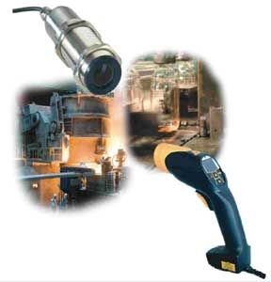
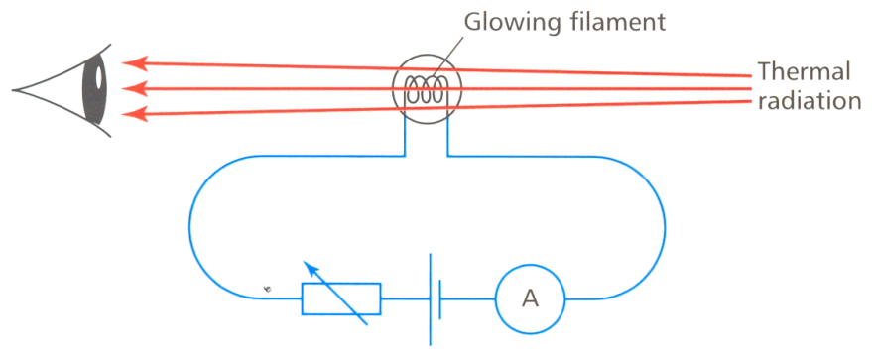
Pyrometer(not in syllabus)
Pyrometers are used to measure very high temperature without contact with the hot body such as a furnace.
The thermometric property used is the colour of thermal radiation from hot objects.
The thermal radiation from the hot object is compared in terms of colour with the thermal radiation from a lamp filament in the pyrometer.
A meter in series with the filament can then be calibrated directly in terms of source temperature.

Slide 25
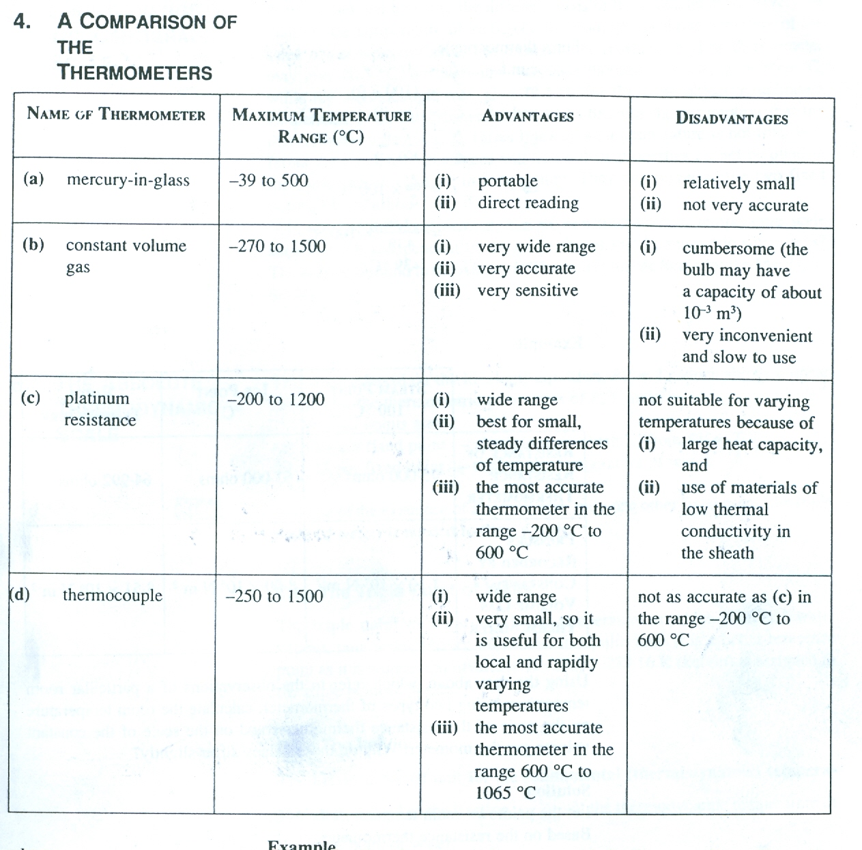
Comparison of Thermometers
IPTS – International Practical Temperature Scale

Slide 26
Shortcomings of Centigrade Scale
If we use different types of thermometer to measure the temperature of the same substance, the readings may be different.
This disagreement arises because the assumption that the thermometric parameter, X, varies linearly with temperature may not be true.
Different thermometric substances and hence their thermometric properties do not respond in the same way to changes in temperature. They only agree at the two fixed points, by definition.
Only the Absolute Thermodynamic Scale is independent of the properties of the thermodynamic substances.

Slide 27
The Thermodynamic Temperature Scale
The thermodynamic temperature scale is now accepted as the fundamental measure of temperature.
It measures temperature in the kelvin (K) unit.
It is also known as the absolute temperature scale.
It has a naturally-defined zero – the absolute zero (0 K).
0 K = -273.15 ºC or 0 ºC = 273.15 K
The absolute zero is the temperature at which the particle constituents of matter are at rest and can be no colder.
It is not based on a thermometric property but on a natural property of gases: pressure is directly proportional to its absolute temperature,
p ∝ T K
Its lower fixed point is the absolute zero and its upper fixed point is the triple point of pure water.
The triple point of a substance is the temperature and pressure at which the three phases (solid, liquid, vapour) of the substance coexist in thermal equilibrium.
For water, its triple point is at 0.01 ºC (273.16 K) and 0.00603 atm.

Slide 28
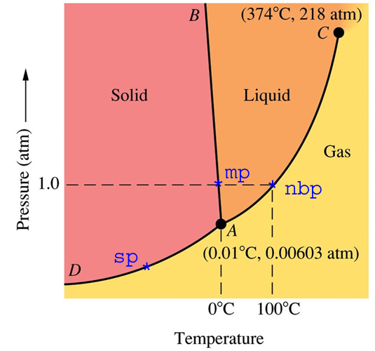
The Triple Point
CLICK IMAGE TO WATCH A VIDEO
http://www.youtube.com/watch?v=qKDW1e3iNfs

Slide 29
Lower & Upper Fixed Points
A temperature scale has to be based on fixed points.
A fixed point is the single temperature at which a particular physical event is sure to happen.
3 Important Fixed Points:
The ice point: the temperature at which pure water exist in equilibrium with water at standard atmospheric pressure (0ºC)
The steam point: the temperature at which pure water can exist in equilibrium with its vapour at standard atmospheric pressure. (100ºC)
The triple point of water: the temperature at which pure ice, pure water and pure water vapour can exist together in equilibrium (0.01ºC / 273.16 K)
The Kelvin scale uses the absolute zero and the triple point of water as the fixed points.

Slide 30
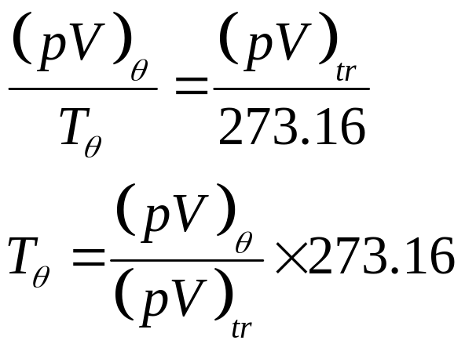
Measuring Temperature
For Centigrade Scale:
For Thermodynamic Scale:
T_{θ} = Temperature to be measured
(pV)_{tr} = p, V at triple point

Slide 31
Example
At the triple point of water, the pressure of a fixed mass of gas is 2500 Pa. The temperature is changed to T while the volume of the gas is kept constant and the pressure is increased to 5000 Pa.
(a) Find the value of T.
(b) Express the temperature T on the Celsius scale.
(c) What is the advantage of making this determination at such a low pressure?
Solution:
(a) T = (pV)_{θ} / (pV)_{tr} × 273.16 = (5000 / 2500) × 273.16 = 546.32 K
(b) T = 546.32 – 273.15 = 273.17 ºC
(c) At low pressure, the value of T approaches the ideal gas temperature.

Slide 32
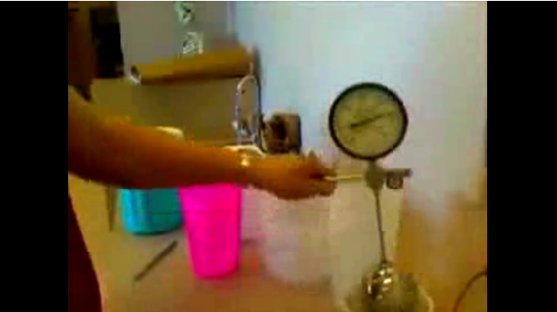
Measuring Absolute Zero
CLICK IMAGE
http://www.youtube.com/watch?v=S6-MD6b713I

Slide 33
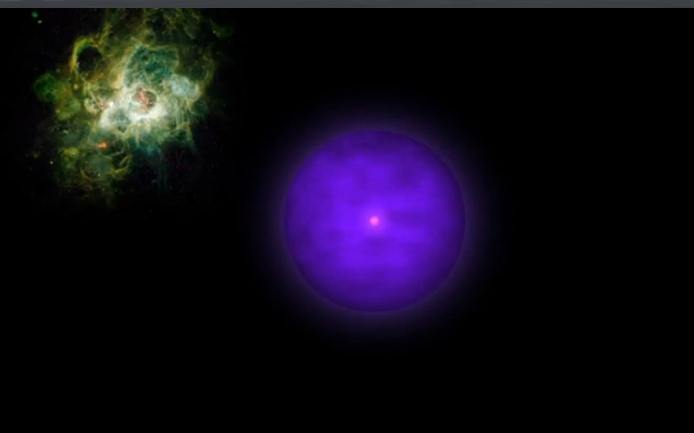
Thermodynamic Temperature
CLICK IMAGE
http://www.youtube.com/watch?v=tfE2y_7LqA4

Slide 34
The End

